Slide 1

CS2009 Design and Analysis of Algorithms
0/1 knapsack problem

Slide 2
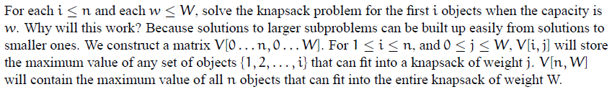
0/1 knapsack problem : Dynamic programming approach

Slide 3
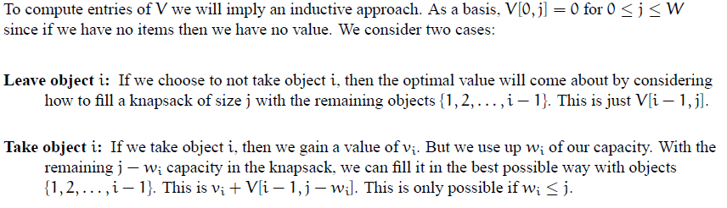

0/1 knapsack problem : Dynamic programming approach

Slide 4
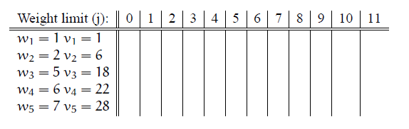
0/1 knapsack problem : Dynamic programming approach
Please note that in class, we created zero row as well. And first of all we filled first row and column with zeros. You can do that too.

Slide 5
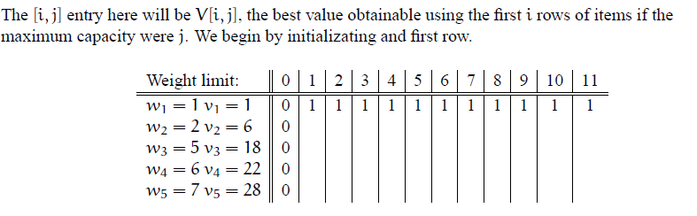
0/1 knapsack problem : Dynamic programming approach

Slide 6
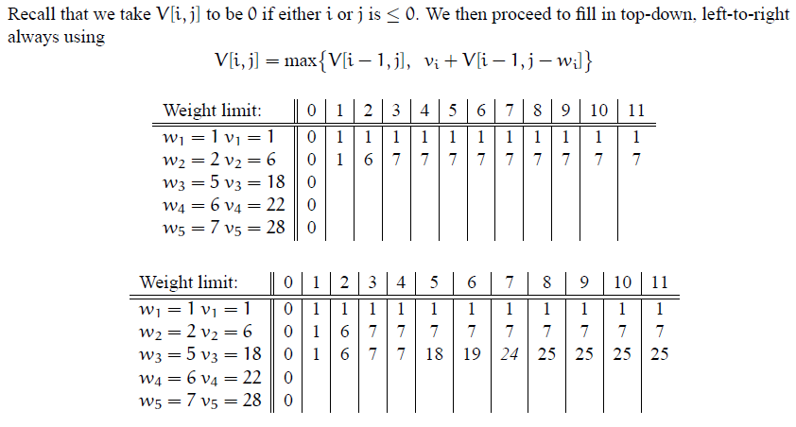
0/1 knapsack problem : Dynamic programming approach

Slide 7
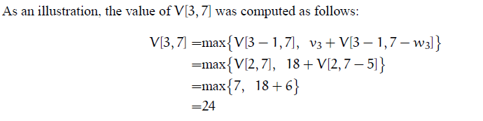
0/1 knapsack problem : Dynamic programming approach

Slide 8
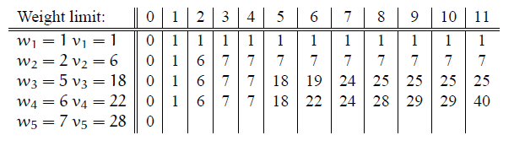
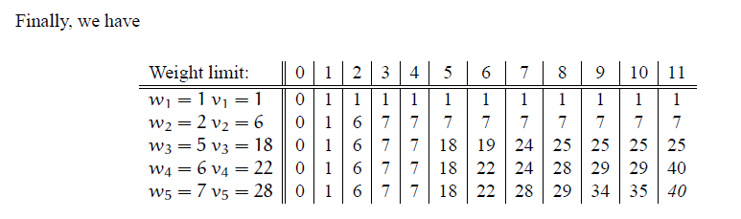
0/1 knapsack problem : Dynamic programming approach

Slide 9
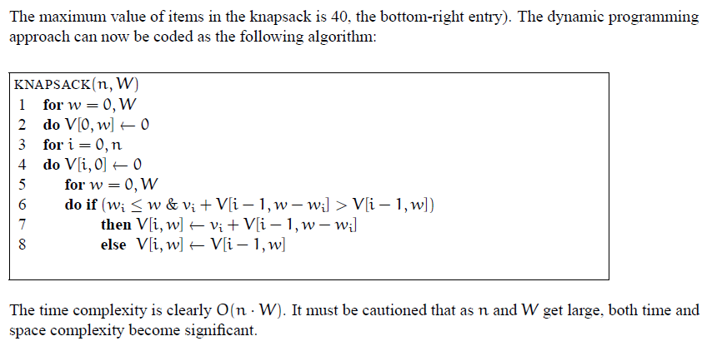
0/1 knapsack problem : Dynamic programming approach

